Slide 1
Angular Introduction

Slide 2
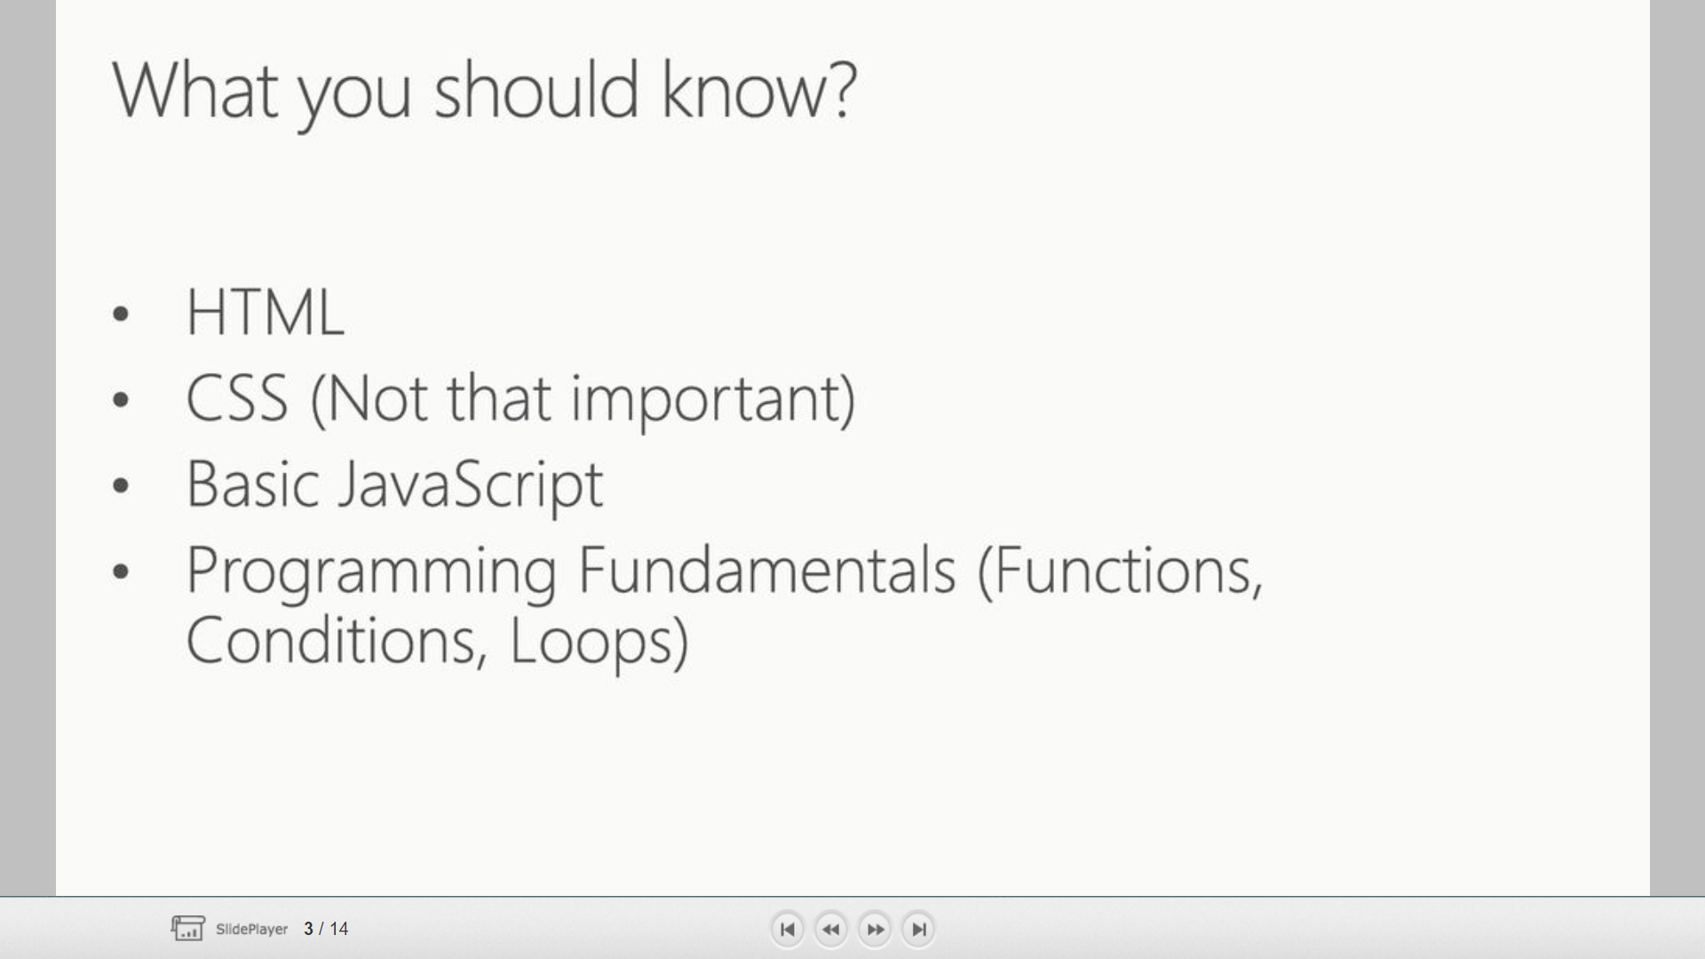

Slide 3
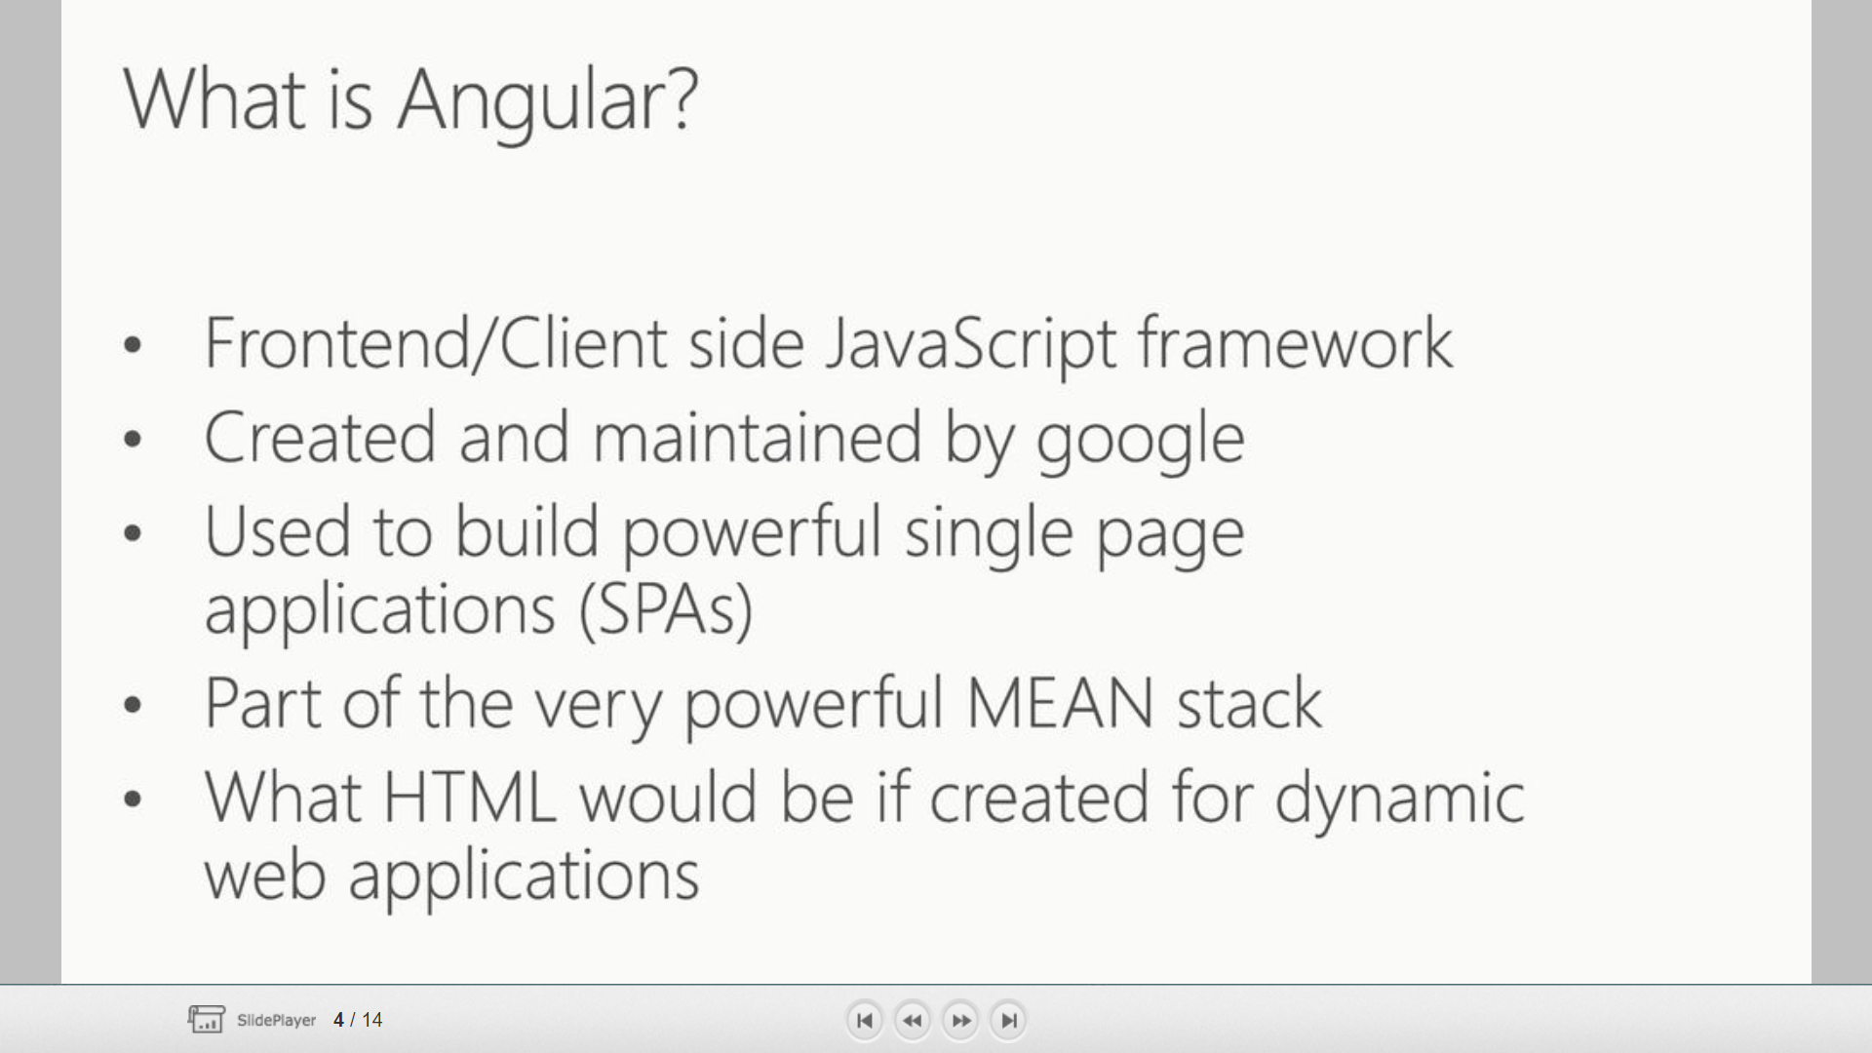

Slide 4
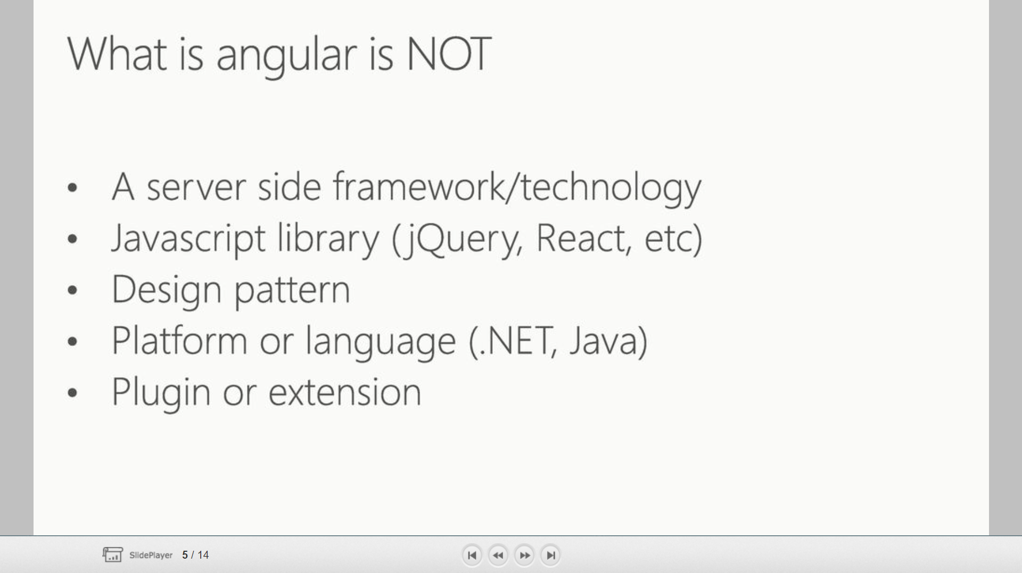

Slide 5
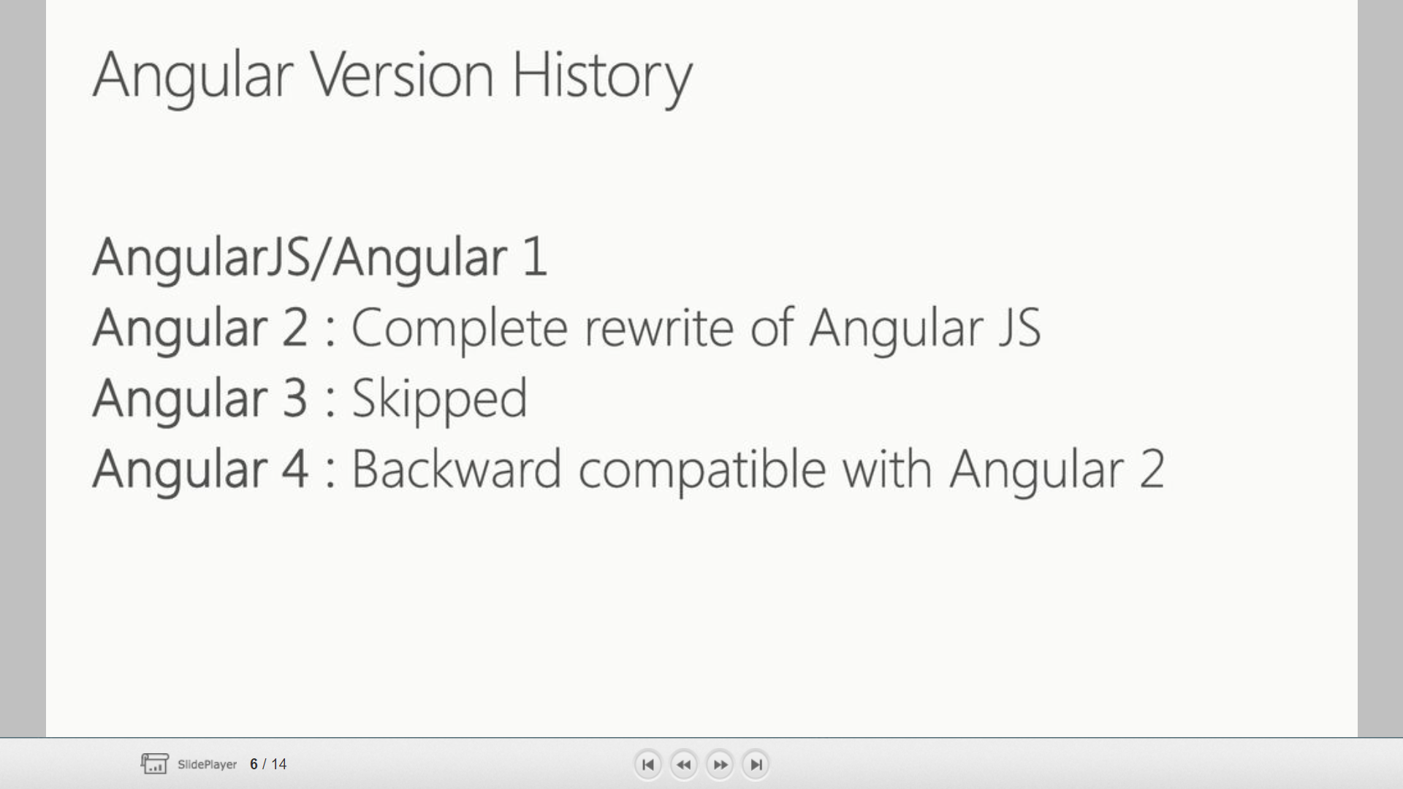

Slide 6
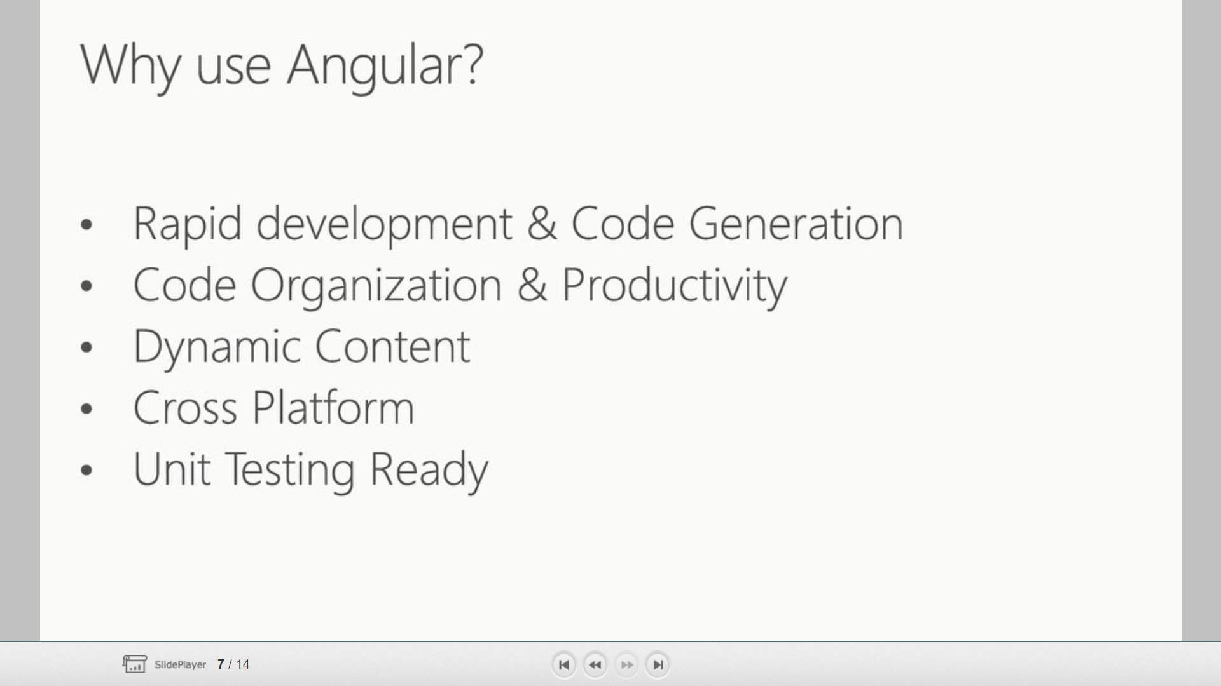

Slide 7
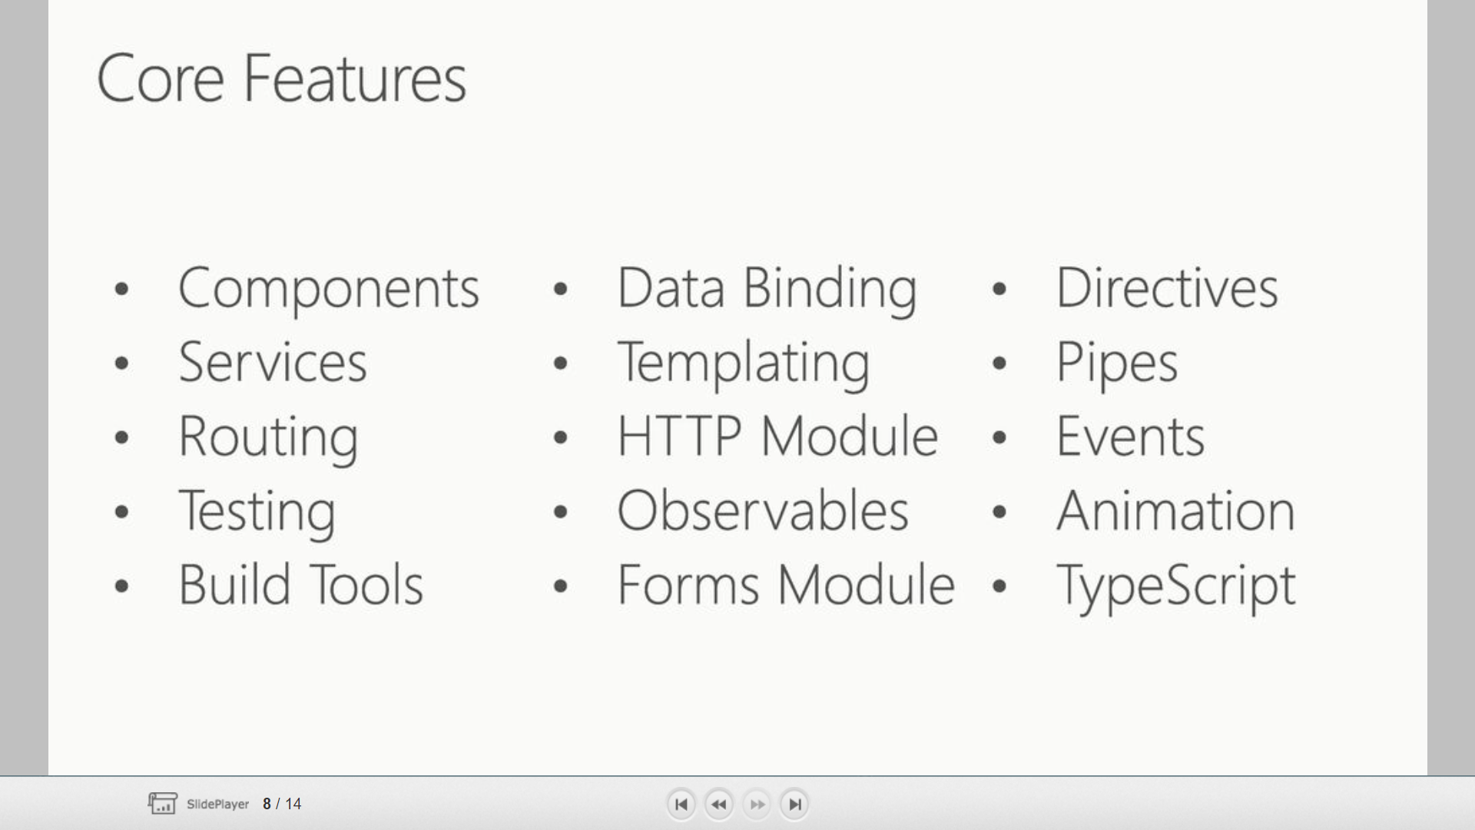

Slide 8
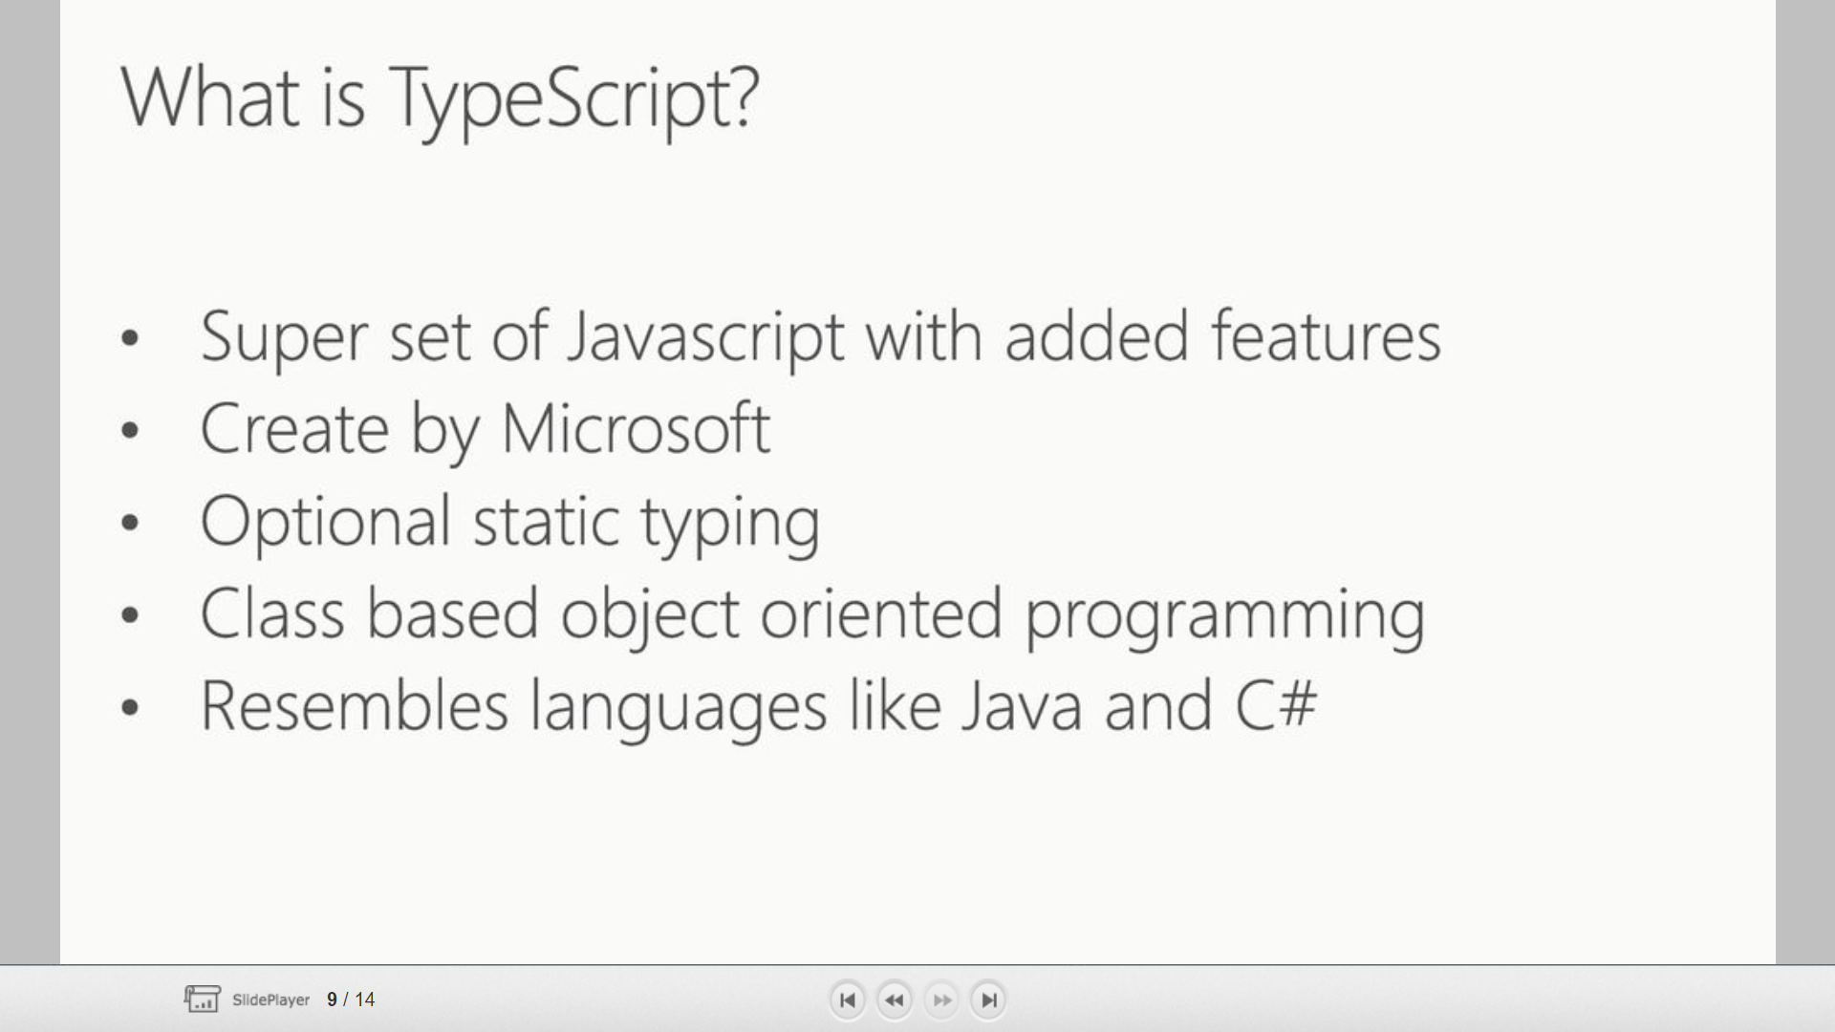

Slide 9
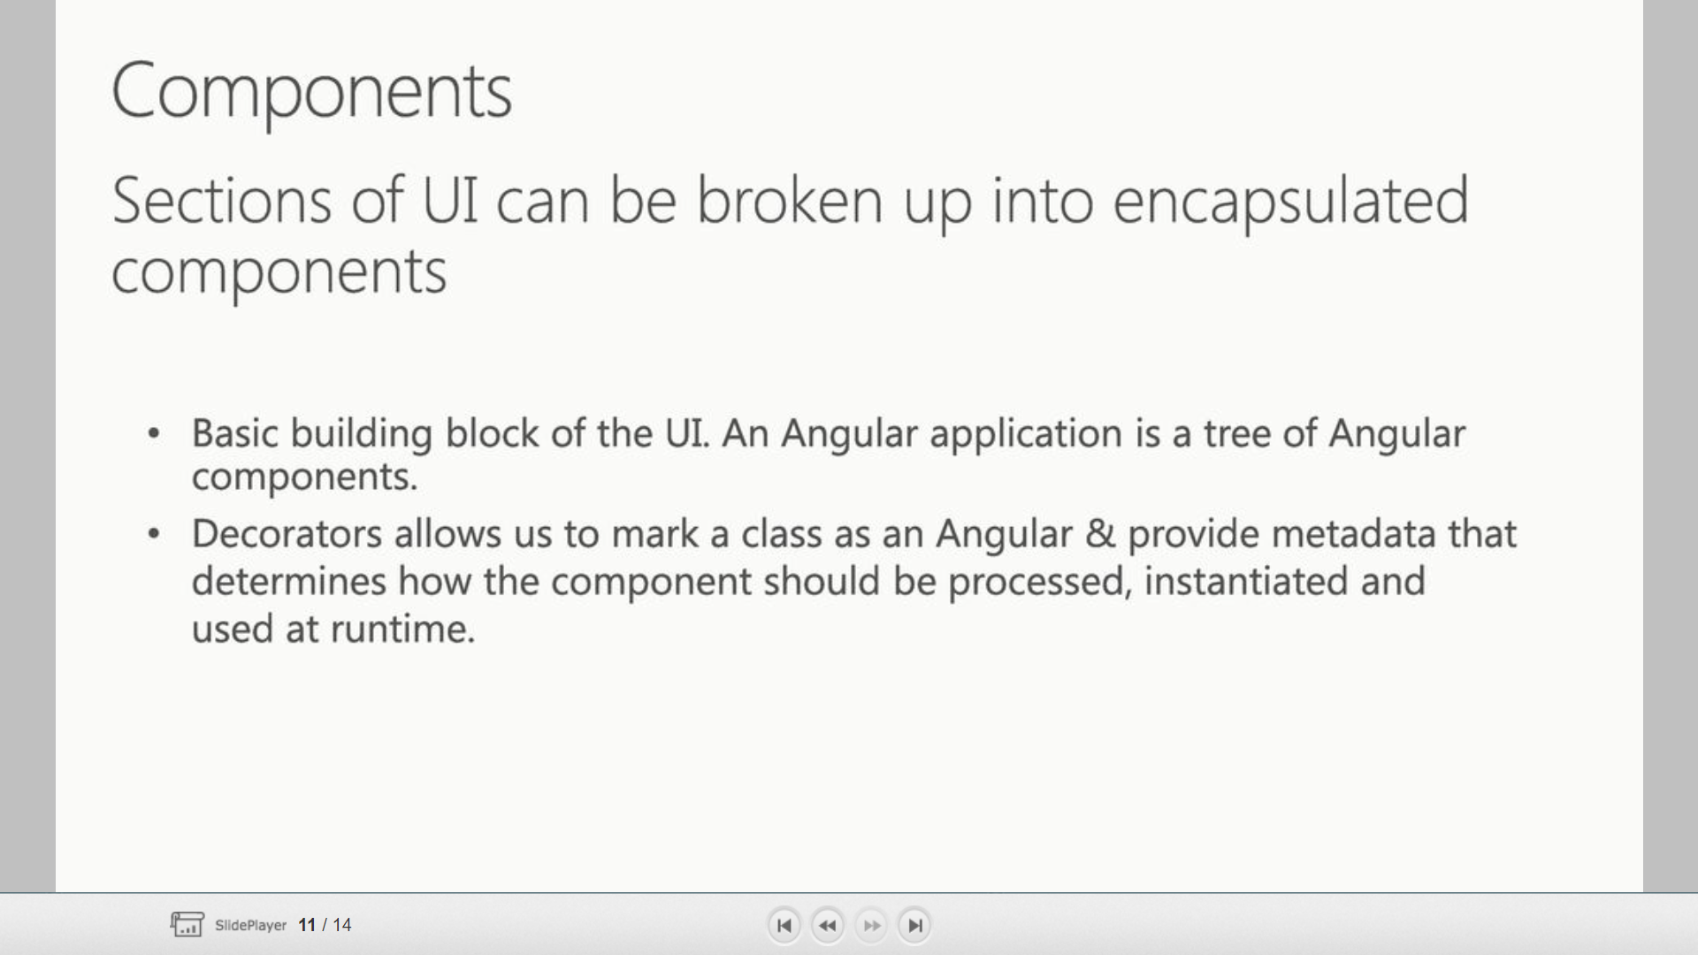

Slide 10
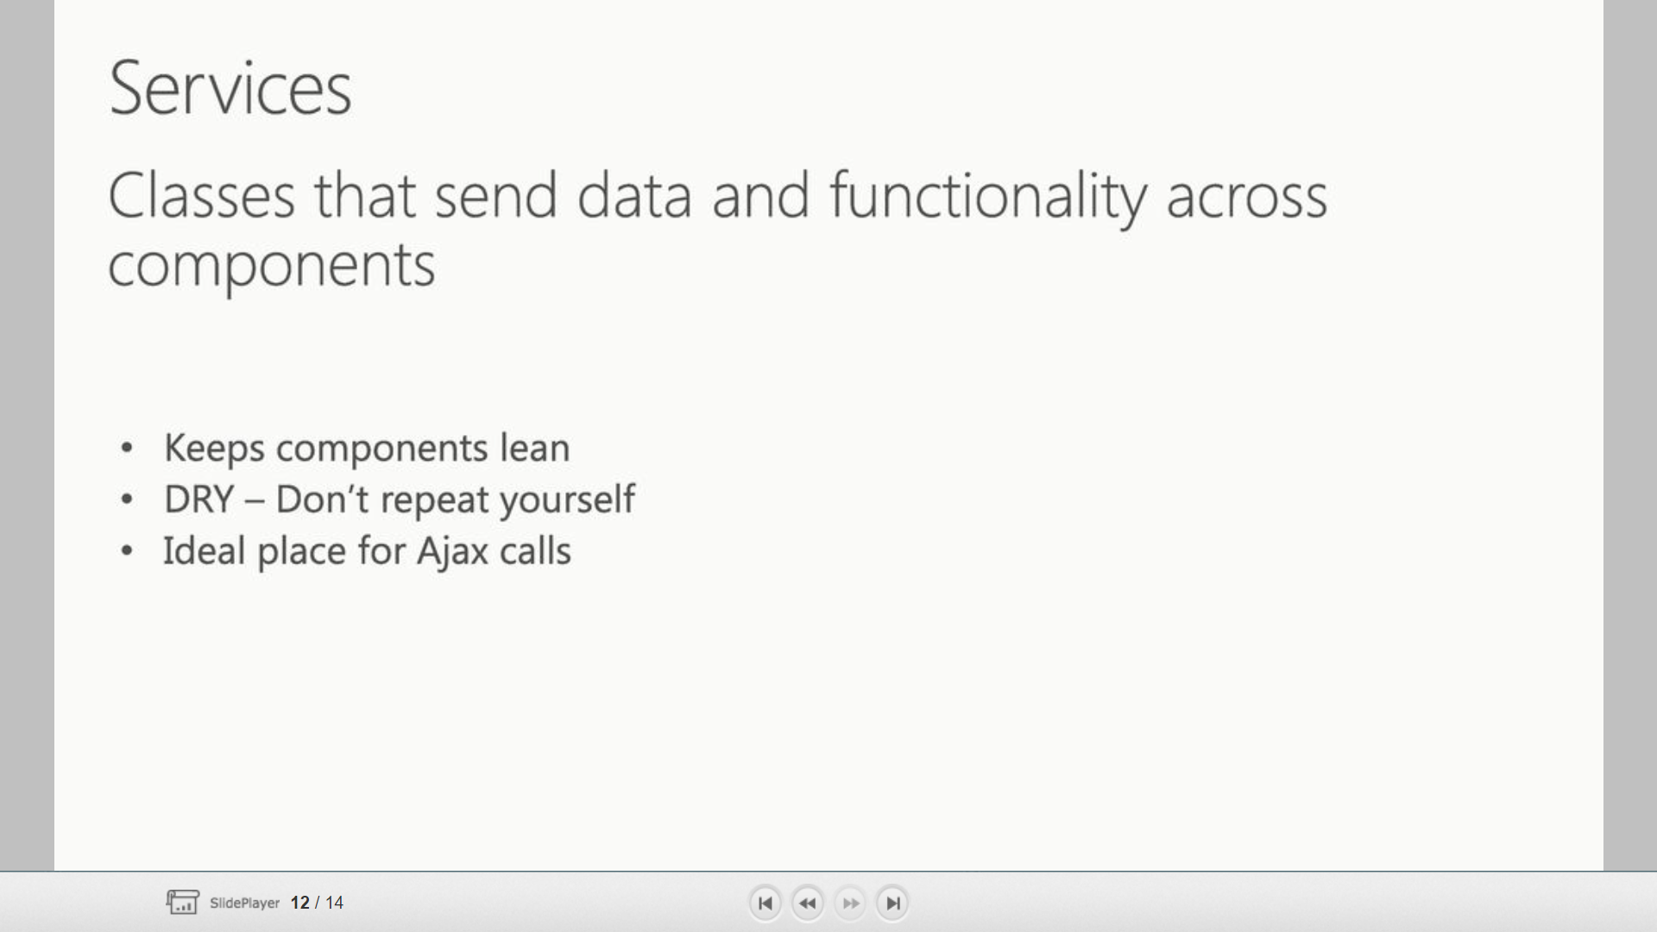

Slide 11
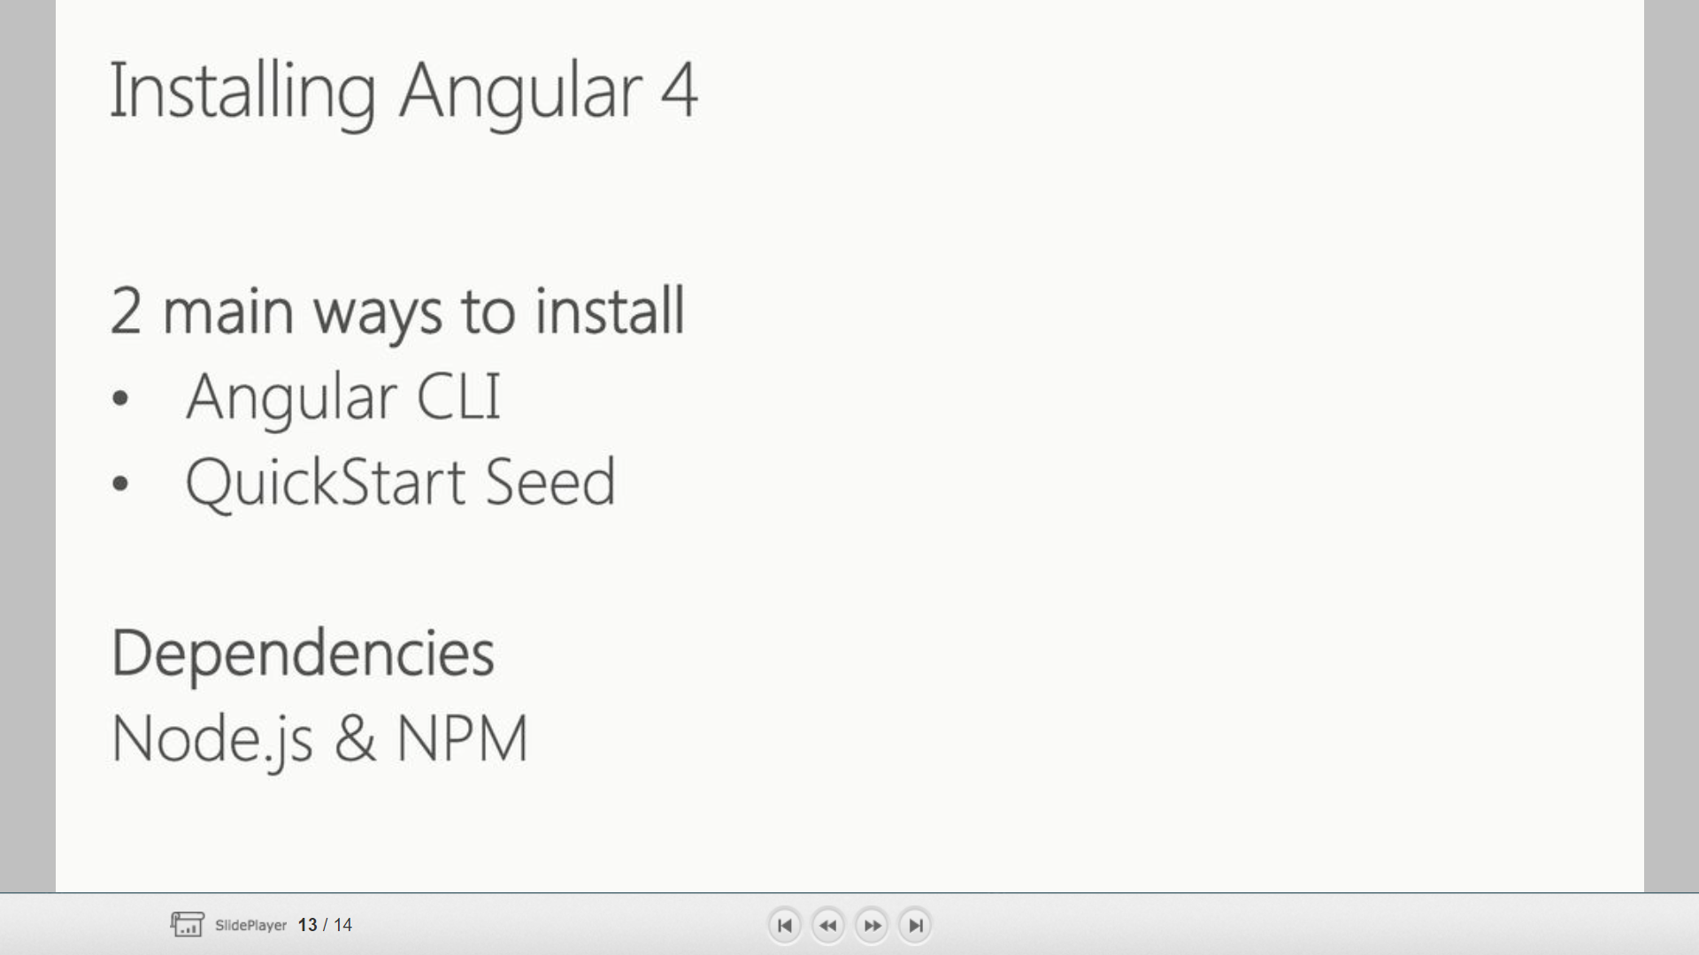

Slide 12
Angular Prerequisites
NodeJS
Install the latest version and confirm them on you command prompt by running the following commands:
node--version
npm--v
Angular CLI
Installation:
npm install -g @angular/cli
Confirmation -
ng--version
Text Editor
Visual Studio Code (VS Code)

Slide 13
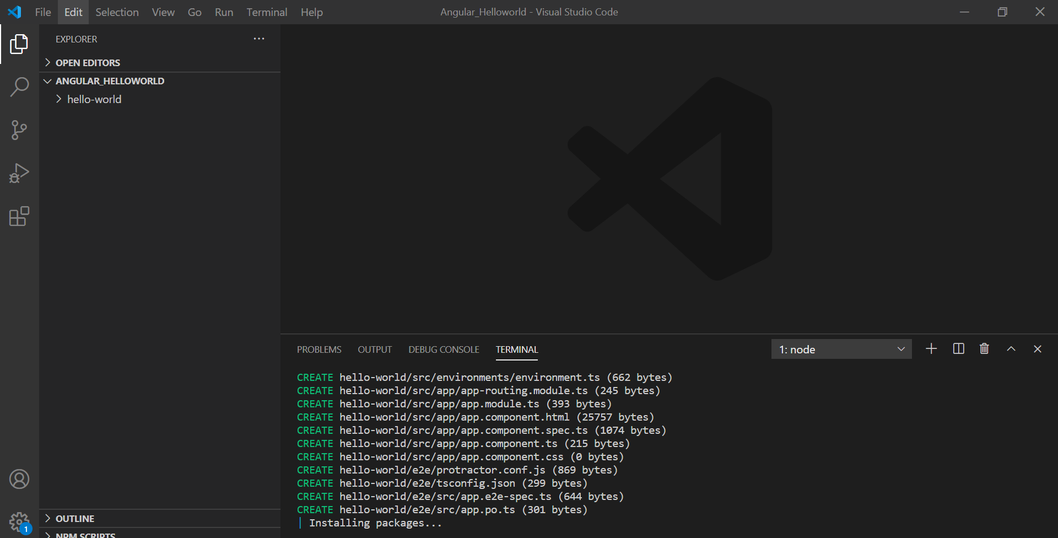
Creating the Angular HelloWorld Application
Step 1
Create a folder for your application in the desired location on your system and open it on VSCode. Open a new terminal and type in the following command to create your app folder.
ng new hello-world

Slide 14
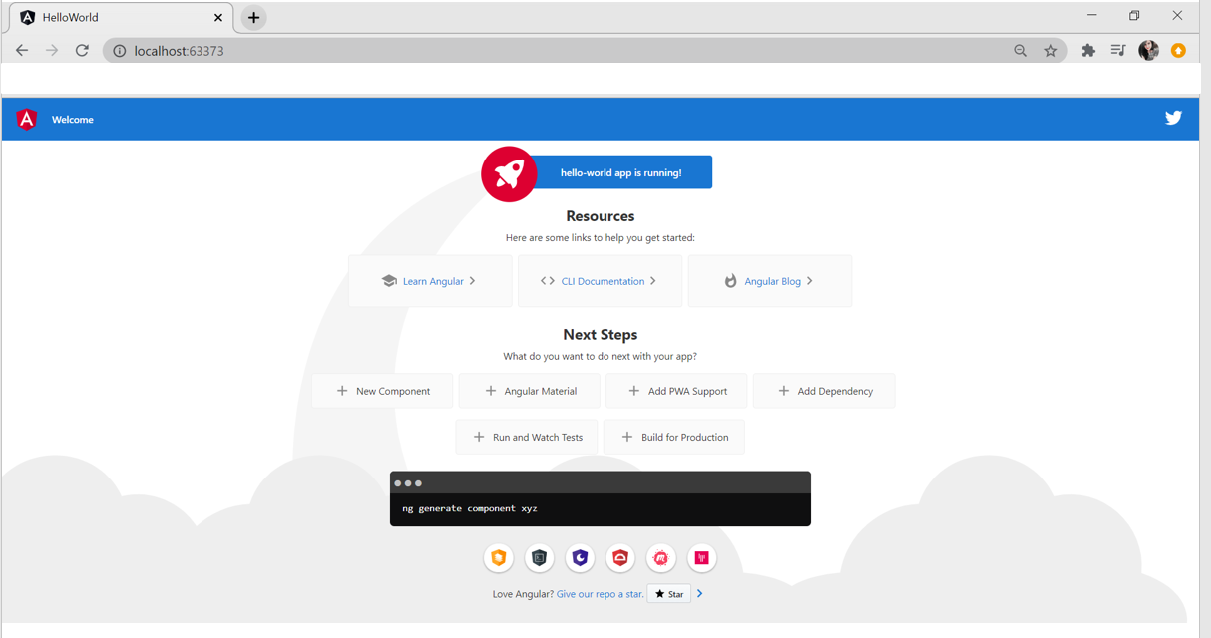
Step 2
To run the application, change the directory to the folder created, and use the ng command.
cd hello-world
ng serve
Once run, open your browser and navigate to localhost:4200

Slide 15
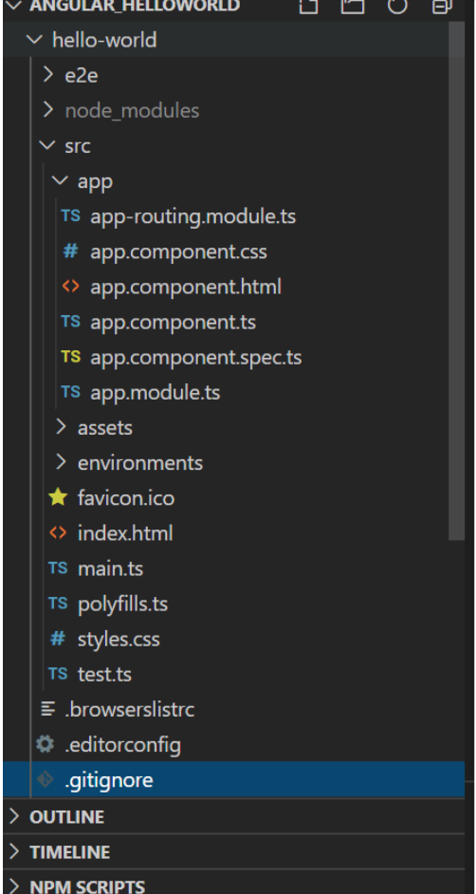

Slide 16
Root HTML - index.html
<!doctype html>
<html lang="en">
<head>
<meta charset="utf-8">
<title>HelloWorld</title>
<base href="/">
<meta name="viewport" content="width=device-width, initial-scale=1">
<link rel="icon" type="image/x-icon" href="favicon.ico">
</head>
<body>
<app-root></app-root>
</body>
</html>

Slide 17
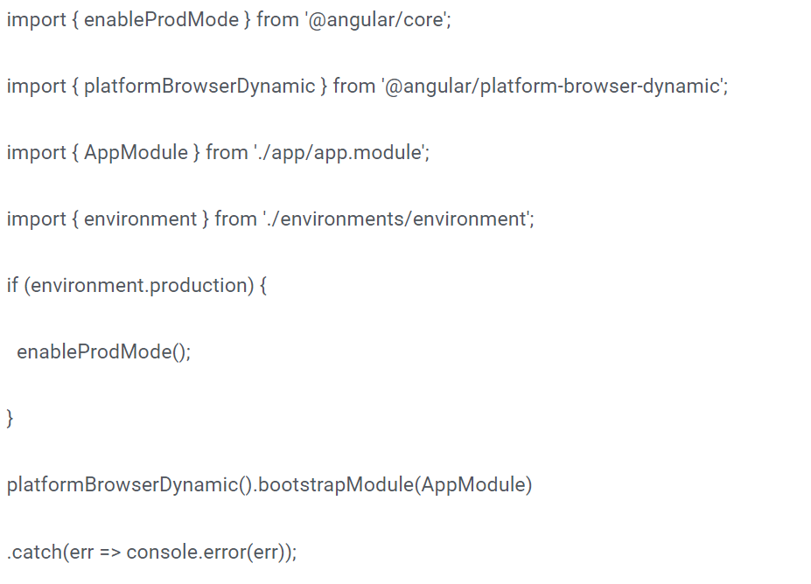
The Entry Point - main.ts

Slide 18
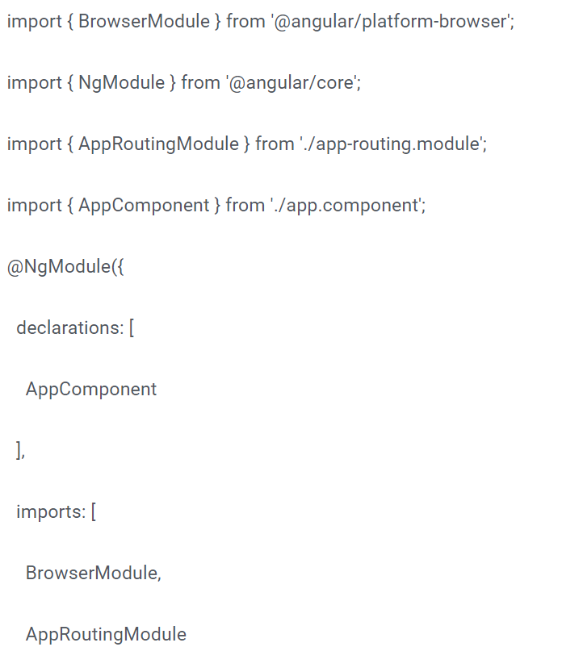
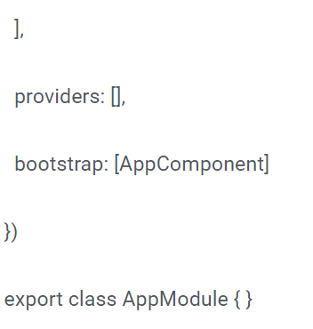
Main Module - app.module.ts

Slide 19
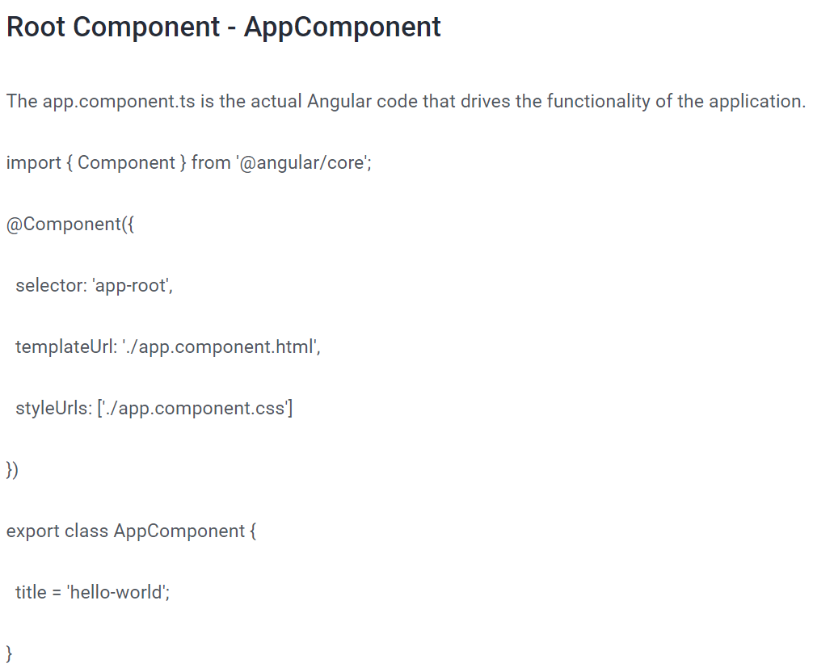

Slide 20
app.component.html file of the Angular HelloWorld application, you can delete all the code and type in something that you wish to render on the browser.
<h1>Hello! Welcome to the Hello-World tutorial</h1>

